Slide 1


Data-Driven Storytelling Presentation:
ACCOUNT PERFORMANCE METRICS AND
SALES TREND
BY
NALLA KARUPPAIAH AL

Slide 2
INTRODUCTION
Problem Statement
J.P. Morgan Chase & Co. is a leading global financial services firm that offers services and operates worldwide.
The company aims to analyze the account performance metrics over the last 5 years (2017-2021) and the factors contributing to its compound annual growth rate (CAGR) in unit sales. This includes identifying opportunities for further improvement.
Business Questions
Examining the total unit sales for each year.
Analyzing the year-over-year growth in sales.
Identifying which account types are surpassing others in terms of unit
Calculating the average 5-year compound annual growth rate (CAGR)
Evaluating the top-performing and bottom-performing accounts.
sales.
based on different account types.

Slide 3
DATA MODELLING
Utilizing Power Query in MS-Excel, transformed the data for improved organization, giving a more structured foundation for necessary analysis.

Slide 4
Overall, our unit sales growth has been good, with a 5- year CAGR of 21%
DATA ANALYSIS & VISUALIZATION
Total Unit Sales
2017
189976
2018
242995
2019
288449
2020
350234
2021
409194
100000 200000 300000 400000 500000
0

Slide 5
DATA ANALYSIS & VISUALIZATION
Directing our sales resources and adjusting our sales mix towards online retailer accounts could lead to enhanced sales growth.
Unit Sales by Account Type and Year
120000
100000
80000
60000
40000
20000
0
2019
Medium Business Online Retailer Small Business
2017 2018
2020 2021
Wholesale Distributor

Slide 6
DATA ANALYSIS & VISUALIZATION
However, Medium Business account type is experiencing higher profitability driven by the average 5-year CAGR.
Average of 5YR CAGR by Account Type
3768.81%
3409.21%
4076.96%
4275.31%
Wholesale Distributor
Small Business Online Retailer Medium Business
0
5
10
15
20
25
30
35
40
45

Slide 7









DATA ANALYSIS & VISUALIZATION
Online Retailer generated the highest sales volume, totaling
408,515 units, which accounts for 28% of the total sales volume.
Medium Business followed closely with a sales volume of
380,568 units, making up 26% of the total sales volume.
Sales by Account Type
23%
26%
Medium Business
Online Retailer Small Business
Wholesale Distributor
23%
28%

Slide 8
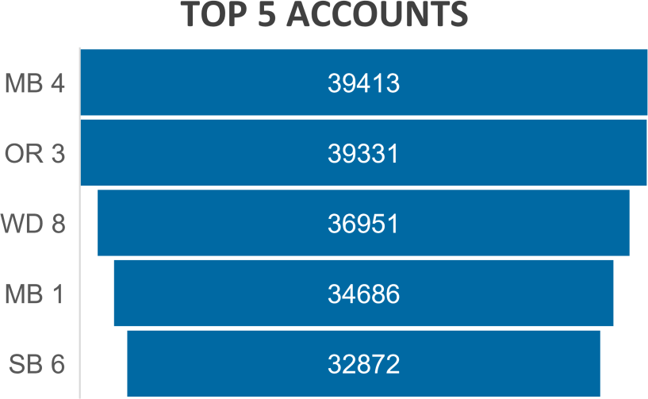
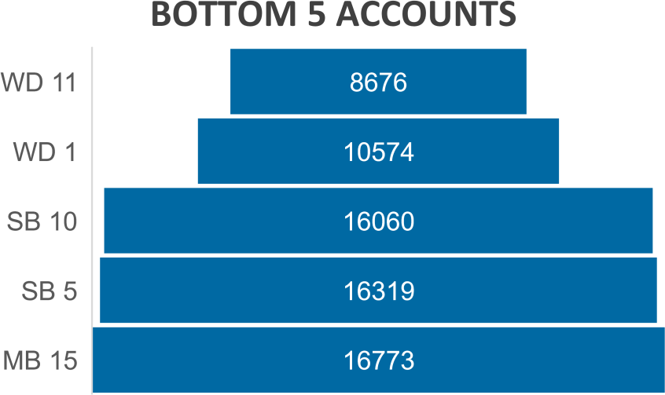
DATA ANALYSIS & VISUALIZATION
The account name MB4 proved to be the highest-performing account, achieving an impressive sales volume of approximately 39,413 units.
On the other hand, accounts WD11, WD1, and SB10 performed at the lowest level in terms of sales volume. Specifically, WD11 accounted for 8,676 units, WD1 for 10,574 units, and SB10 for 16,060 units, all in terms of sales volume

Slide 9
SUMMARY
Despite satisfactory overall sales performance, there is ample
room for significant improvement.
Discontinuing poorly performing accounts would free up valuable sales and marketing resources.
Notably, the past five years have witnessed the most robust
sales growth in the online retailer account category.
By reallocating the resources saved from closing underperforming accounts to online retailer accounts, sales growth could be maximized.
It is advisable to promptly close these underperforming accounts and launch an initiative to identify high-potential online retailer accounts deserving of increased sales and marketing focus.

